Slide 1
Mobile Security

Slide 2
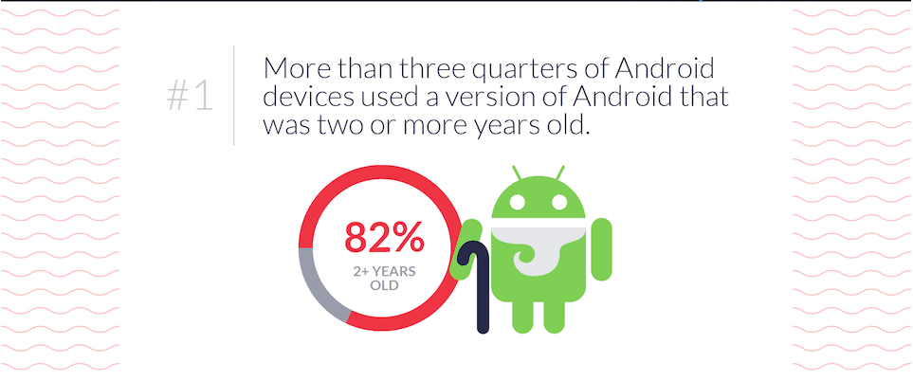
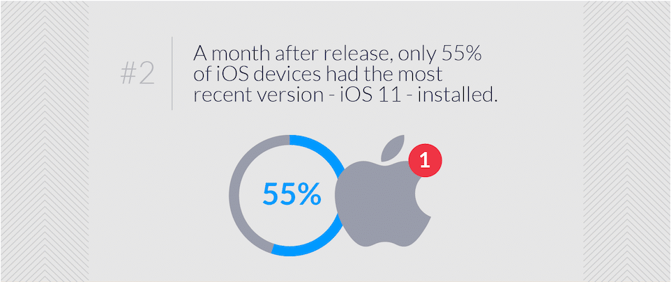
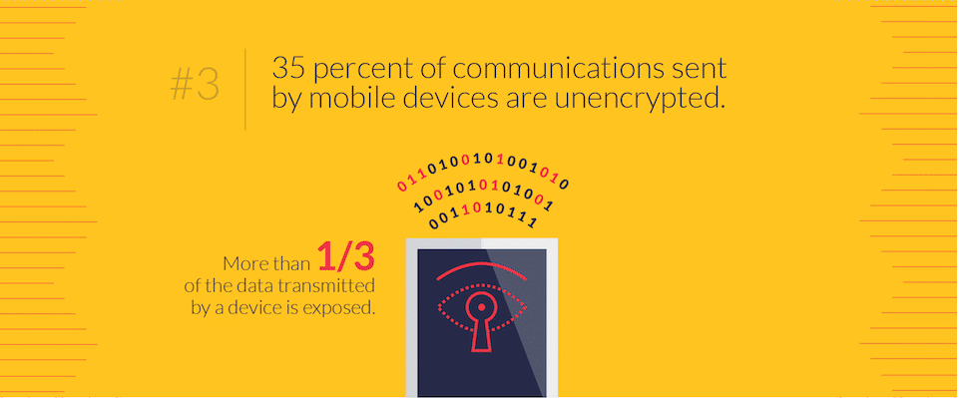
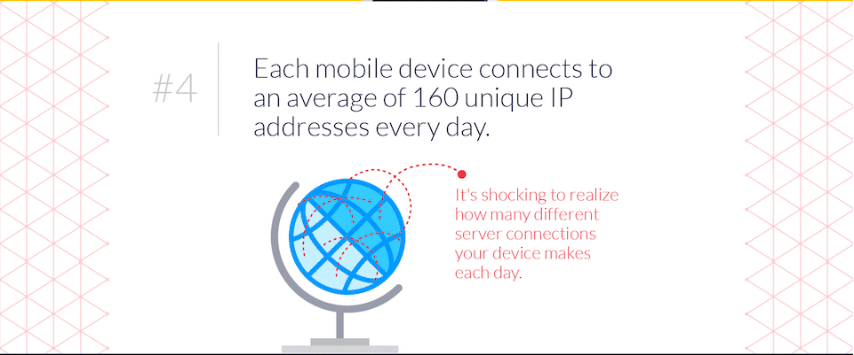
MOBILE DANGERS STATISTICS

Slide 3
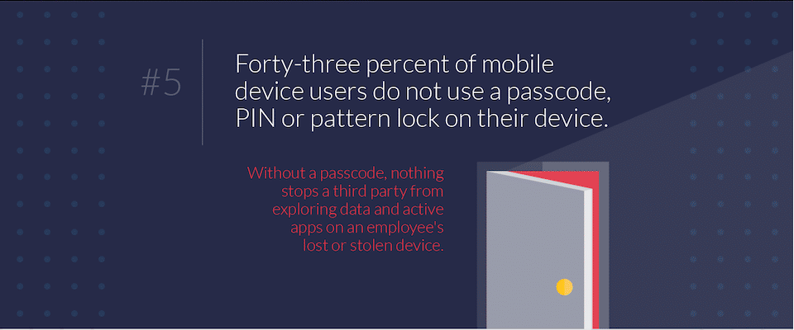
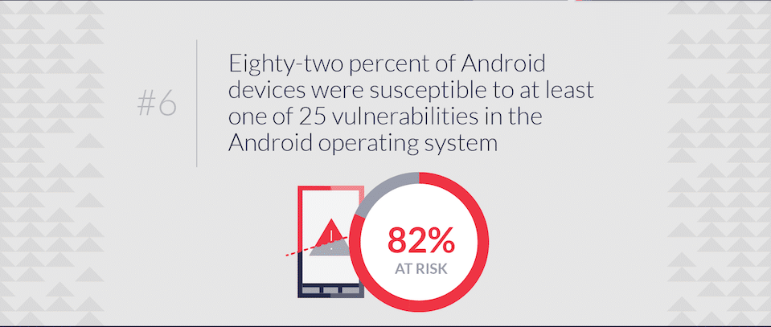
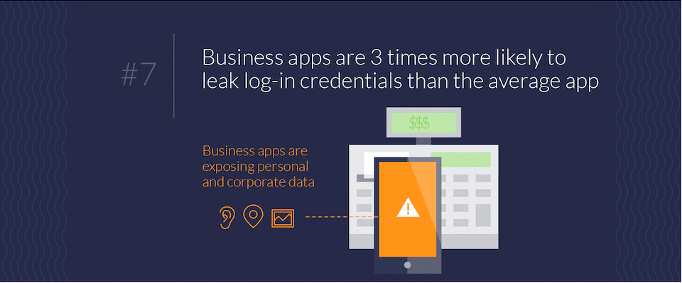
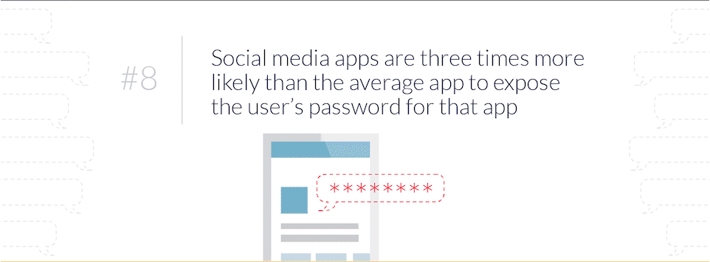
MOBILE DANGERS STATISTICS

Slide 4
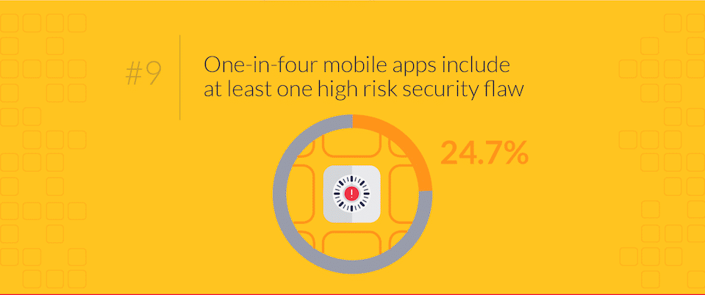
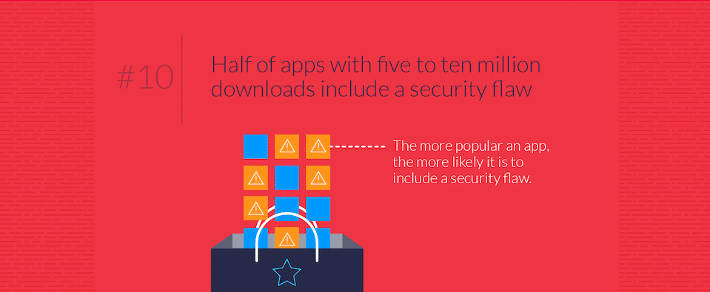
MOBILE DANGERS STATISTICS

Slide 5
THE MOBILE RISK MODEL
Who are the stakeholders?
Mobile network operators (MNOs)
Device manufacturers (OEMs)
Mobile operating system (OS) vendors
Application Store curators
Organizational IT
Mobile application developers
End users

Slide 6
THE MOBILE RISK MODEL
What items are valuable to these stakeholders?
Each stakeholder places different values on assets within the mobile device.
Threats according to an OS manufacturer include all applications as well as the phone’s user! (why would anyone try to jailbreak the phone as soon as they get it home?!)
To the phone’s user, however, the OS may be a threat (why does it want to capture data and export it for “statistical purposes?”) or even applications preloaded by the MNO.
Threats attack each stakeholder’s assets by interacting with attack surfaces.
Browser-based Internet applications mostly confine the attack surface to the Internet connection itself, a server’s data stores, a browser’s rendering and scripting engines or nowadays, native apps with embedded capabilities for displaying web views

Slide 7
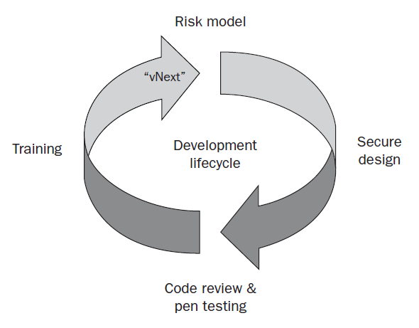
THE MOBILE RISK MODEL
What risks are relevant to these assets from each stakeholder’s perspective?
Image Source: Neil Bergman, Mike Stanfield, Jason Rouse, Joel Scambray, Hacking Exposed™: Mobile Security Secrets & Solutions, 2013, McGraw-Hill Education

Slide 8
BASIC CELLULAR NETWORK FUNCTIONALITY
Interoperability
Voice Calls
The Control Channels
Voice Mailboxes
Short Message Service (SMS)

Slide 9
ATTACKS AND COUNTERMEASURES
Hacking Mobile Voicemail
Rogue Mobile Devices
Rogue Femtocell Attacks
Set a complex voicemail password
Configure access so that entering the password is required in all cases
Need to develop a dependable, open, and correct method of mutual authentication between the mobile stations and mobile networks, replacing one-way trust
Rogue Base Stations

Slide 10
CORE SECURITY FEATURES OF iOS
Secure Boot Chain
At each step of the Secure Boot Chain, each of the relevant components that have been cryptographically signed by Apple is verified to check if integrity is maintained.
When an iOS device is powered on, the processor executes the Boot ROM, which is implicitly trusted by the device and burned onto the chip while manufacturing.
The boot ROM contains the public key for Apple’s Root CA, which is used to verify the integrity of the next step of the Secure Boot Chain, the low-level bootloader (LLB).
Boot ROM
LLB
iBoot
iOS Kernel

Slide 11
CORE SECURITY FEATURES OF iOS
Secure Boot Chain
The LLB performs a number of setup routines, including locating the iBoot image in flash memory before booting from it.
The LLB looks to maintain the Secure Boot Chain by verifying the signature of the iBoot image, and if the signature does not match the expected value, the device boots into recovery mode.
iBoot, which is the second-stage bootloader, is responsible for verifying and loading the iOS kernel, which in turn goes on to load the user mode environment and the very familiar iOS.
Boot ROM
LLB
iBoot
iOS Kernel

Slide 12
CORE SECURITY FEATURES OF iOS
Secure Enclave
The Secure Enclave is a coprocessor shipped with A7 and A8 chip devices that uses its own secure boot and software update processes, independent from the main application processor.
It handles cryptographic operations on the device, specifically the key management for the Data Protection API and Touch ID fingerprint data.
It uses a customized version of the ARM TrustZone to partition itself from the main processor and provide data integrity even if the device’s kernel becomes compromised.
In short, this means that if the device is jailbroken or otherwise compromised, extracting cryptographic material such as biometric fingerprint data from the device should be impossible.

Slide 13
CORE SECURITY FEATURES OF iOS
Restricting Application Processes with Code Signing
It is a runtime security feature of the platform that attempts to prevent unauthorized applications from running on the device by validating the application signature each time it is executed.
It also ensures that applications may execute only code signed by a valid, trusted signature.
Isolating Applications with Process-Level Sandboxing
All third-party applications on iOS run within a sandbox, a self-contained environment that isolates applications not only from other applications but also from the OS.
Assuming a piece of malware has bypassed the App Store review process, it would not be able to steal sensitive information unless the user grants it the relevant permissions.

Slide 14
CORE SECURITY FEATURES OF iOS
Protecting Information with Data-at-Rest Encryption
By default, all data on the iOS file system is encrypted using AES with the file system key, which is generated on first boot and instrumental in implementing the device’s remote wipe capability.
Individual files and keychain items can be encrypted using the Data Protection API, which uses a key derived from the device passcode.
Protecting Against Attacks with Exploit Mitigation Features
The implementation of the write-but-not-execute (W^X) memory policy enforces that memory pages cannot be marked as writeable and executable at the same time.
Address space layout randomization (ASLR) looks to randomize where data and code are mapped in a process’ address space, allowing applications with position-independent execution (PIE) to be loaded.
Stack-smashing protection is a compiler-based defense against traditional stack-based overflow exploits by introducing stack canaries, which allows applications to forcibly terminate if it has been corrupted.

Slide 15
iOS APPLICATIONS
Standard Native Applications
Objective-C
Browser-based Applications
Loaded via MobileSafari
Use traditional web technologies
Hybrid Applications
Combination of native and browser-based applications
Swift

Slide 16
JAILBREAKING
Jailbreaking is a process done to take full control of an iOS device.
The end result?
Customization: The Cydia Store!
Installation of utility apps or app extensions
Configuring the device to allow remote access via SSH or VNC
Install or compile arbitrary software directly
The jailbreak process involves exploiting a series of vulnerabilities to take over a device.
Functionality is lost (failure in app loading)
Code signature validation is disabled
“Bricking” is also very much possible

Slide 17
JAILBREAKING
Methods
Boot-based
Takes control of the device during the boot process and pushes a customized firmware image to the device.
Popular tools: Redsn0w, greenpois0n, limera1n
Remote
Loads a file onto a device that first exploits and takes control of a userland process, and then exploits and takes control of the kernel.
Popular tools: Jailbreakme, corona/absinthe, evasi0n

Slide 18
POPULAR iOS ATTACKS
The JailbreakMe3.0 Vulnerabilities
Avoid jailbreaking!
iKee Attacks!
The first worm targeting iOS
Scan IP blocks assigned to telecom providers in the Netherlands and Australia; identify devices with TCP port 22 open, and then attempt to log in with the default credentials “root” and “alpine”
Do not jailbreak, or else change the default passwords on jailbroken devices.
The FOCUS 11 Man-in-the-Middle Attack
iFrame containing a link to a PDF capable of rooting the device
Keep the OS and software updated with latest patches
Combination of a PDF bug and a kernel bug
Keep the OS and software updated with latest patches
Be wary of rogue wireless networks: Ask to Join Networks!

Slide 19
POPULAR iOS ATTACKS
Malicious Apps in the App Store: Handy Light, InstaStock
Handy Light: Allowed users to tap the flashlight color options in a particular order that then launched a SOCKS proxy server on the phone that could be used to tether a computer to the phone’s cellular Internet connection.
InstaStock: Designed to exploit a 0-day vulnerability in iOS that allowed the app to load and execute unsigned code; was limited only to Mobile Safari and only for the purpose of enabling JIT compilation of JavaScript, but was available for all apps.
Update to official firmware releases regularly
Be selective about using apps
Vulnerable Apps: Bundled and Third Party
Keep iOS and all installed apps as up to date as possible
Physical Access
Ensure that all sensitive data on the device has been encrypted.
Have a passcode of at least six digits in length set and in use at all times.
Use software that can remotely track the location of a device or remotely wipe sensitive data.

Slide 20
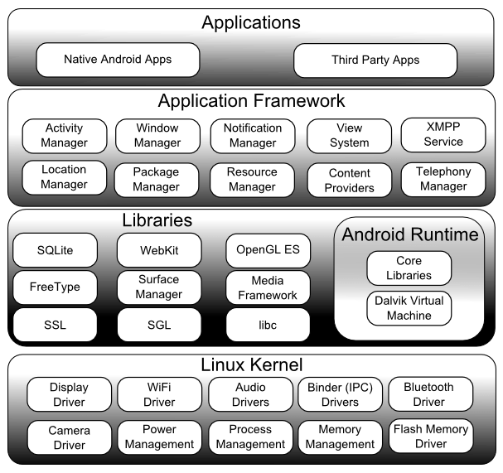
THE ANDRIOD OS
Image Source: [17/08/2018] https://www.techotopia.com/index.php/An_Overview_of_the_Android_Architecture

Slide 21
ANDRIOD SECURITY MODEL
The Android security model is permission based.
Permissions are enforced in two places in the Android architecture: at the kernel level and at the Application Framework level.
Kernel Level Permissions
All applications are assigned a unique user ID. This restricts applications to accessing only the resources and functionality that they have explicitly been granted permission to.
Application Framework Level Permissions
To access restricted functionality provided by the Application Framework, an Android application must declare a permission for that component in its manifest file (AndroidManifest.xml), which provides the user to choose what permissions to grant to the application at install-time.

Slide 22
ANDRIOD SECURITY MODEL
Categories of Application Framework Permissions
Normal
Dangerous
Signature
Low-risk permissions that grant access to non-sensitive data or features.
These permissions do not require explicit approval from the user at install time.
These permissions grant access to sensitive data and features and require explicit approval from the user at install time.
This category of permission can be defined by an application in its manifest.
Functionality exposed by applications that declare this permission can only be accessed by other applications that were signed by the same certificate.
signatureOrSystem
Same as signature, but applications installed on the /system partition (which have elevated privileges) can also access this functionality.

Slide 23
ANDRIOD APPLICATION COMPONENTS
Each component of the Android application represents a different entry point into the application, in which the system or another application on the same mobile device can enter.
Applications primarily use intents, which are asynchronous messages, to perform inter-process, or inter-component, communication.
Activities
Content providers
Broadcast receivers
Services
Defines a single screen of an application’s user interface.
Exposes the ability to query, insert, update, or delete application-specific data to other applications and internal components.
Responds to broadcast intents.
Runs in the background and perform lengthy operations.

Slide 24
DATA STORAGE
Android applications can either utilize internal storage by storing data in nonvolatile memory (NAND flash) or utilize external storage by storing data on a Secure Digital (SD) card.
Files stored in external storage are publicly available to all to applications, and files stored in internal storage are, by default, private to a specific application unless an application choses to do otherwise by changing the default Linux file permissions.
Poor cryptographic methods to encrypt stored data may lead to information leakage, irrespective of whether it is stored in either internal or external storage.
Android applications are free to create any type of file, but the Android API comes with support for SQLite databases and shared preference files stored in an XML-based format.
The use of client-side relational databases obviously introduces the possibility of SQL injection attacks against Android applications via either intents or other input, such as network traffic.

Slide 25
ROOTING
If an application can run under the root user, however, the Android security model breaks down.
An application running under the root user can directly access device resources, bypassing the permission checks normally required—and potentially giving the application full control over the device and the other applications installed on it.
Although the Android community tends to view “rooting” as a way for users to gain more control over their device (to install additional software or even custom ROMs), a malicious application can use these same techniques to gain control of a device.

Slide 26
COMMON ANDROID ATTACKS
Rootkits
Decompiling and Disassembly
Intent-based Attacks (Command Injection)
NFC-based Attacks
Information Leakage
Man-in-the-Middle Attacks

Slide 27
OWASP MOBILE TOP 10
1. Improper Platform Usage
This category covers misuse of a platform feature or failure to use platform security controls.
It might include Android intents, platform permissions, misuse of TouchID, the Keychain, or some other security control that is part of the mobile operating system.
2. Insecure Data Storage
This covers insecure data storage and unintended data leakage.
3. Insecure Communication
This covers poor handshaking, incorrect SSL versions, weak negotiation, cleartext communication of sensitive assets, etc.

Slide 28
OWASP MOBILE TOP 10
4. Insecure Authentication
This category captures notions of authenticating the end user or bad session management, which can include:
Failing to identify the user at all when that should be required
Failure to maintain the user's identity when it is required
Weaknesses in session management
5. Insufficient Cryptography
The code applies cryptography to a sensitive information asset, which is insufficient in some way.
This category is for issues where cryptography was attempted, but it wasn't done correctly.

Slide 29
OWASP MOBILE TOP 10
6. Insecure Authorization
This is a category to capture any failures in authorization (e.g., authorization decisions in the client side, forced browsing, etc.)
If the app does not authenticate users at all in a situation where it should (e.g., granting anonymous access to some resource or service when authenticated and authorized access is required), then that is an authentication failure not an authorization failure.
7. Client Code Quality
This would be the catch-all for code-level implementation problems in the mobile client. That's distinct from server-side coding mistakes.
This would capture things like buffer overflows, format string vulnerabilities, and various other code-level mistakes where the solution is to rewrite some code that's running on the mobile device.

Slide 30
OWASP MOBILE TOP 10
8. Code Tampering
This category covers binary patching, local resource modification, method hooking, method swizzling, and dynamic memory modification.
Once the application is delivered to the mobile device, the code and data resources are resident there.
An attacker can either directly modify the code, change the contents of memory dynamically, change or replace the system APIs that the application uses, or modify the application's data and resources.
This can provide the attacker a direct method of subverting the intended use of the software for personal or monetary gain.

Slide 31
OWASP MOBILE TOP 10
9. Reverse Engineering
This category includes analysis of the final core binary to determine its source code, libraries, algorithms, and other assets.
Many binary inspection tools give the attacker insight into the inner workings of the application.
This may be used to exploit other nascent vulnerabilities in the application, as well as revealing information about back end servers, cryptographic constants and ciphers, and intellectual property.
10. Extraneous Functionality
Often, developers include hidden backdoor functionality or other internal development security controls that are not intended to be released into a production environment.
For example, a developer may accidentally include a password as a comment in a hybrid app. Another example includes disabling of 2-factor authentication during testing.

Slide 32
TIPS FOR SECURE MOBILE DEVELOPMENT
Leverage SSL/TLS
Input Validation
Use the Least Privilege Model for System Access
Sign the Application’s Code
Use a Secure and Strong Update Process
Leverage the Permissions Model Used by the OS
Store Sensitive Information Properly
Understand the Mobile Browser’s Strengths and Limitations
Zero-out the Non-threats
Use User-secure/intuitive URLs
Follow Secure Coding Practices

